Slide 1
Neural Network
Neural
Network

Slide 2
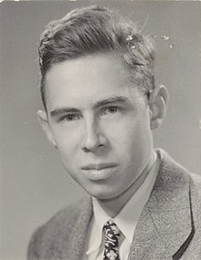
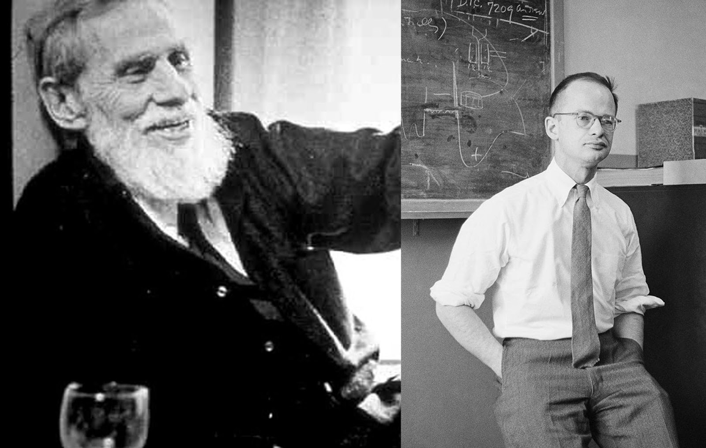
Embedding non-linearity
Frank
Rosenblatt
Warren Sturgis McCulloch
Walter Pitts
Rosenblatt was best known for the Perceptron, an electronic device which was constructed in accordance with biological principles and showed an ability to learn
Warren Sturgis McCulloch (November 16, 1898 – September 24, 1969) was an American neurophysiologist and cybernetician, known for his work on the foundation for certain brain theories and his contribution to the cybernetics movement. Along with Walter Pitts, McCulloch created computational models based on mathematical algorithms called threshold logic which split the inquiry into two distinct approaches, one approach focused on biological processes in the brain and the other focused on the application of neural networks to artificial intelligence

Slide 3
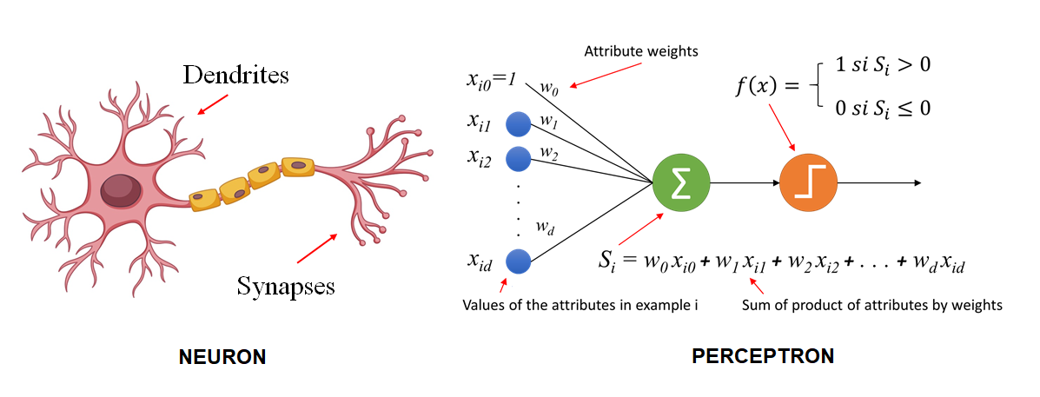
Neurons and Perceptrons
a design based on the functioning of brain neurons, which receive signals through their dendrites and, in response to certain combinations of them, emit signals through the synapses.

Slide 4
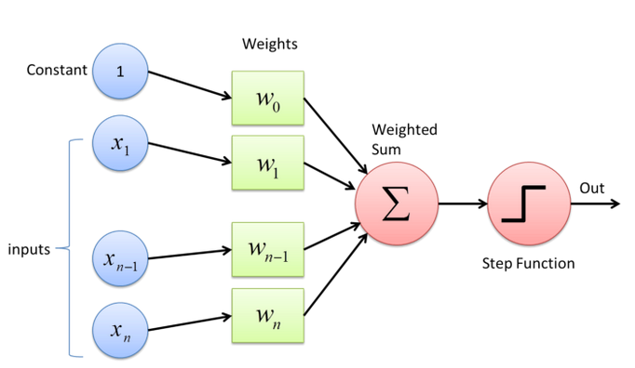
Perceptron

Slide 5
Perceptron Numeric Example
Weights | Input (X) | W * X
0.5 | 0.8 | 0.4
0.4 | -0.5 | -0.2
0.9 | 0.1 | 0.09
Σ |  | 0.29
Output |  | 1
Weights | input | Product
0.3 | 0.8 | 0.24
0.4 | -0.5 | -0.2
-0.9 | 0.1 | -0.09
Σ |  | -0.05
Output |  | 0

Slide 6
Class Ex.
0
1
0.3
-0.4
0.4
0
-0.6
what is the output of this network?
How will the output change if X3 will be 0.6 instead of -0.6
How can you change one weight to flip the output?

Slide 7
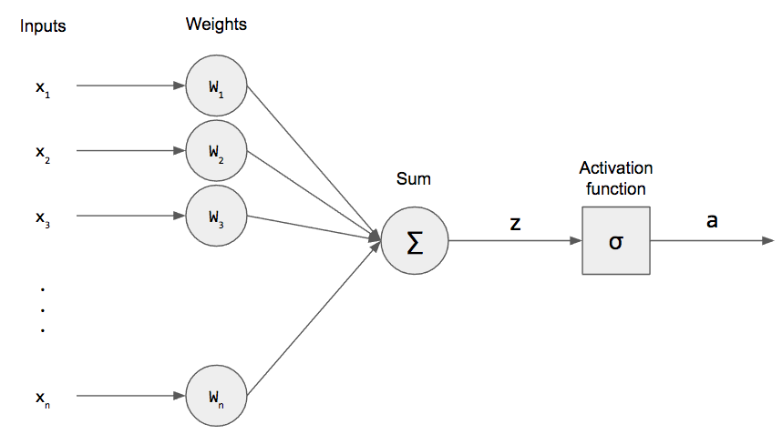
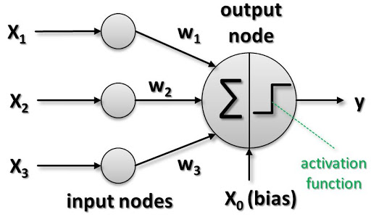
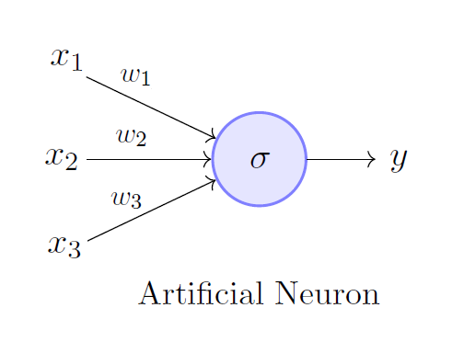
Different schemes presenting the exact same thing

Slide 8
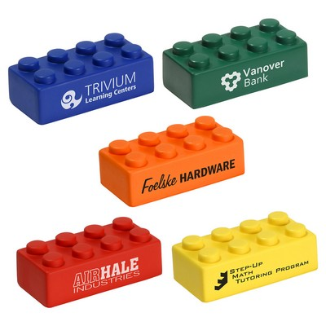
What can we build with Perceptron?
What is the solution space when using a perceptron as the building block?

Slide 9
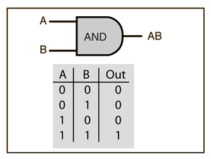
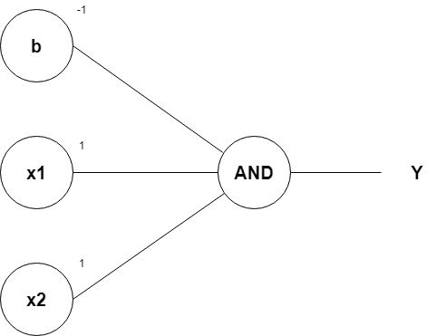
Perceptron AND Logic gate
https://medium.com/@stanleydukor/neural-representation-of-and-or-not-xor-and-xnor-logic-gates-perceptron-algorithm-b0275375fea1

Slide 10
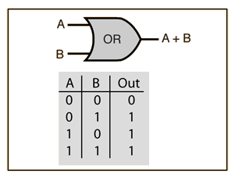

Perceptron OR Logic gate

Slide 11
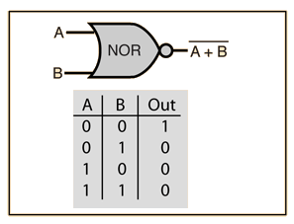
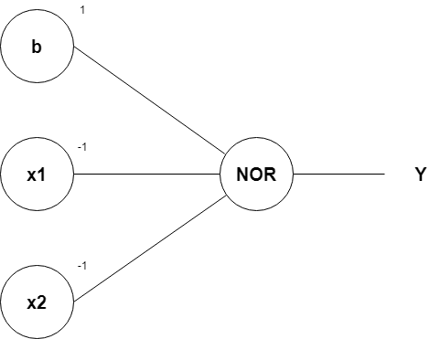
Perceptron NOR Logic gate

Slide 12
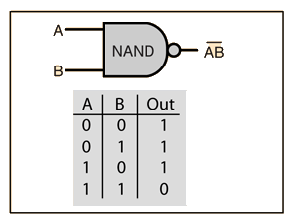

Perceptron NAND Logic gate
Class Ex

Slide 13
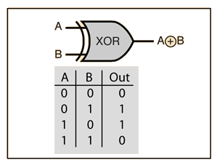
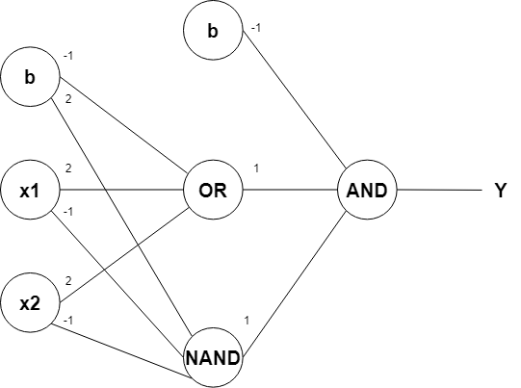
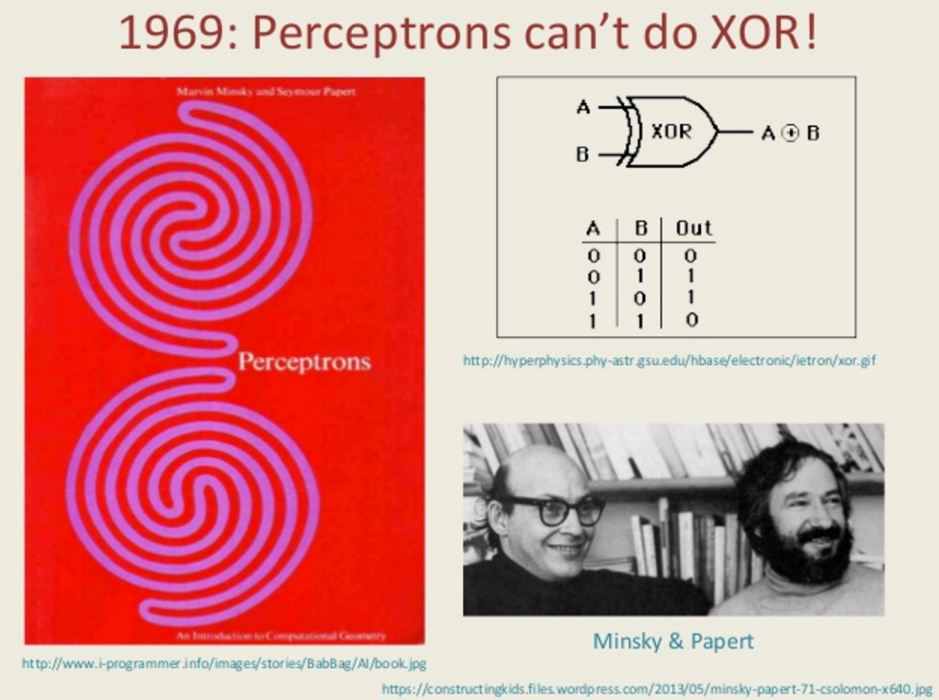
Perceptron XOR Logic gate

Slide 14
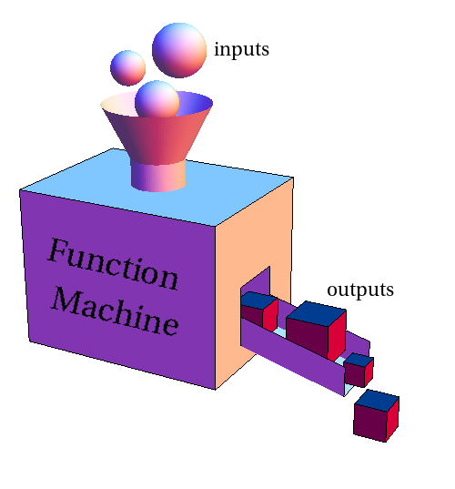


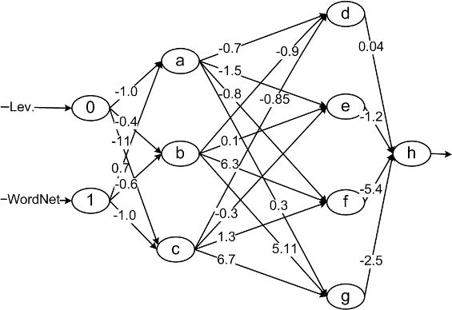
Image Classifier
Given images that have only 2 pixels that can be black or white, We want to build a classifier which can tell if both cells have the same color or not.
Can you come up with a NN that will solve the classification?
Class Ex
Same color?

Slide 15
Same color classifier solution
0
Same color?
0
1
1

Slide 16
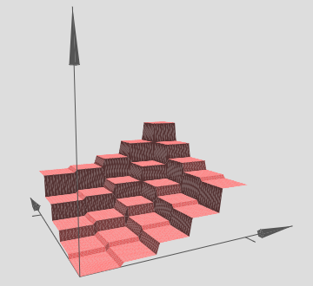
functionally complete
The NAND Boolean function (and also NOR) has the property of functional completeness. This means, any Boolean expression can be re-expressed by an equivalent expression utilizing only NAND operations
In logic, a functionally complete set of logical connectives or Boolean operators is one which can be used to express all possible truth tables by combining members of the set into a Boolean expression
Visual proof by Nielsen : http://neuralnetworksanddeeplearning.com/chap4.html

Slide 17
Perceptron functionally complete - Visual Proof Intuition
f1
F1+f2
0
f2

Slide 18
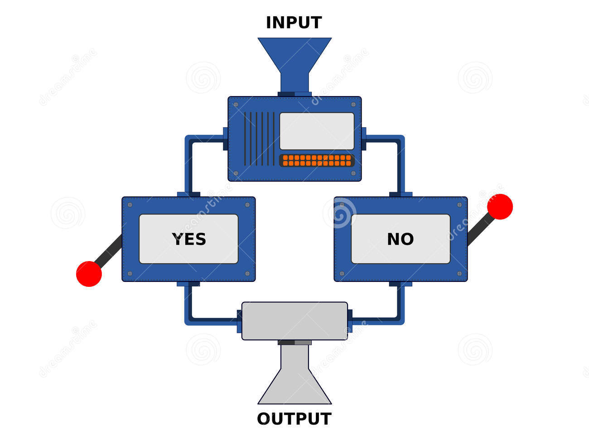


Perceptron as a Decision Machine
Go to the party or not, this is the question

Slide 19
Perceptron party example
factors | var | Weight
Number of friends (int) | x1 | 1
Cost (in 100NIS) (real) | x2 | -1
Time to get there (in hours) | x3 | -0.5
Total
factors | var | Weight | value | Impact
Number of friends (int) | x1 | 1 | 3 | 3
Cost (in 100NIS) (real) | x2 | -1 | 200NIS | -2
Time to get there (in hours) | x3 | -0.5 | 0.5 | -0.25
Total |  |  |  | 0.75
Danny

Slide 20
Perceptron party example
factors | var | Weight
Number of friends (int) | x1 | 1
Cost (in 100NIS) (real) | x2 | -1
Time to get there (in hours) | x3 | -0.5
Total
factors | var | Weight | value | Impact
Bias | B (x0) | -1 | 1 | -1
Number of friends (int) | x1 | 1 | 3 | 3
Cost (in 100NIS) (real) | x2 | -1 | 200NIS | -2
Time to get there (in hours) | x3 | -0.5 | 0.5 | -0.25
Total |  |  |  | -0.25
Sandy

Slide 21
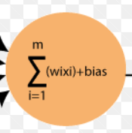
Bias – The predisposition
What is the decision threshold when all the inputs are 0?

Slide 22

Take home message
Basic Perceptrons are decision machines which depend on their input, weights and bias.
They sum up the inputs and then use a step function.
Networks with enough Perceptrons can provide solutions to every function (universal functions).

